Slide 1
Bicycle Safety

Slide 2
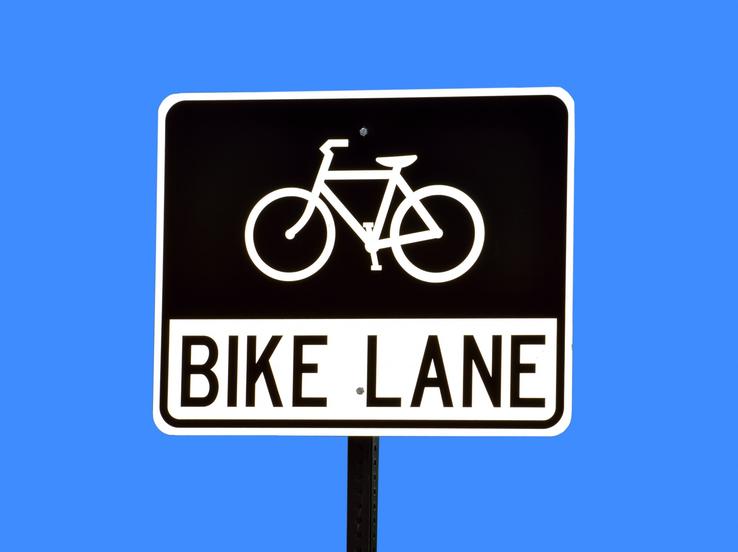
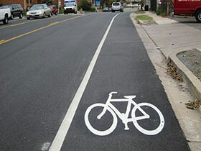
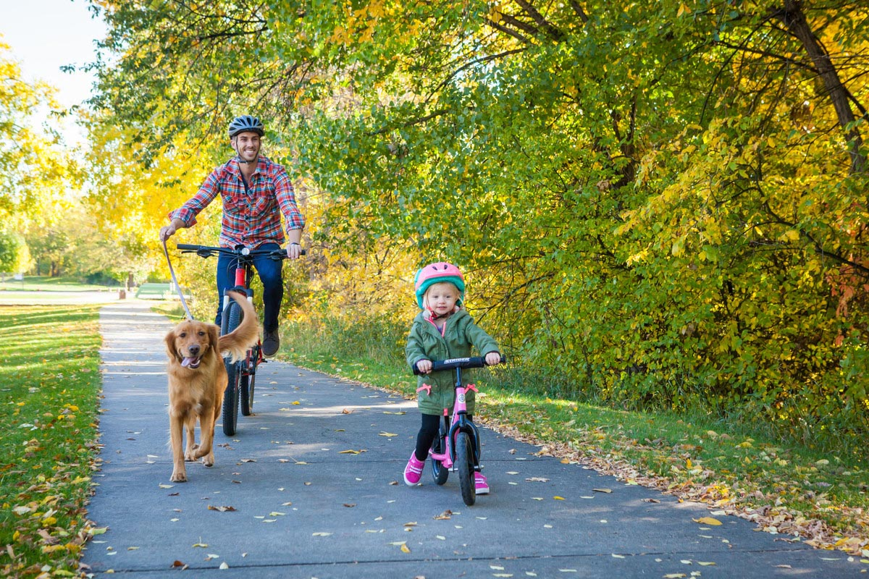
Safe Places to Ride

Slide 3
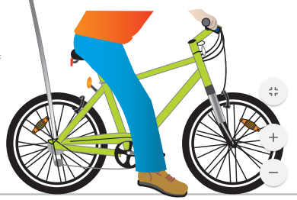
Is your bicycle the right size?
The rider should be able to sit on the seat both feet just touching the ground.
If the seat is in the lowest position and you cannot touch both feet to the ground, the bicycle is too large.
Notes:
If the bike is too big:
-The child will feel less confident
-The bike will be harder for them to handle
-It will be less enjoyable for them to ride
-Less SAFE.

Slide 4
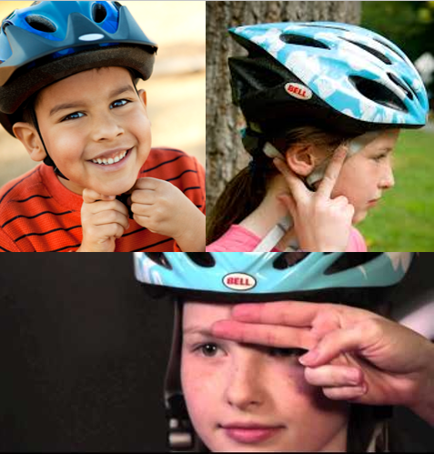
Wear your Helmet
Eyebrow test
Peace sign test
Chin strap test

Slide 5
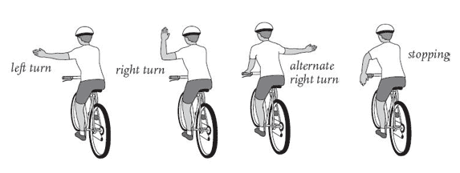
Hand Signals

Slide 6
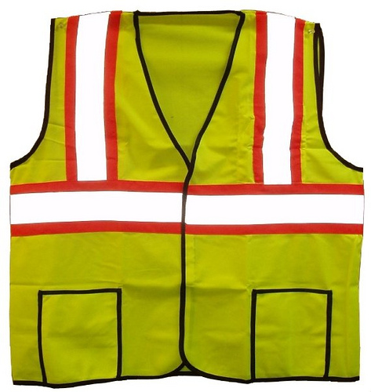
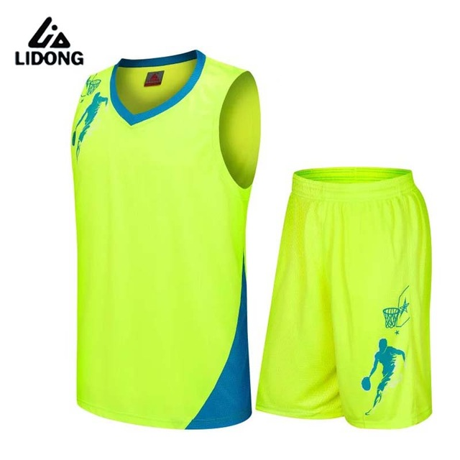
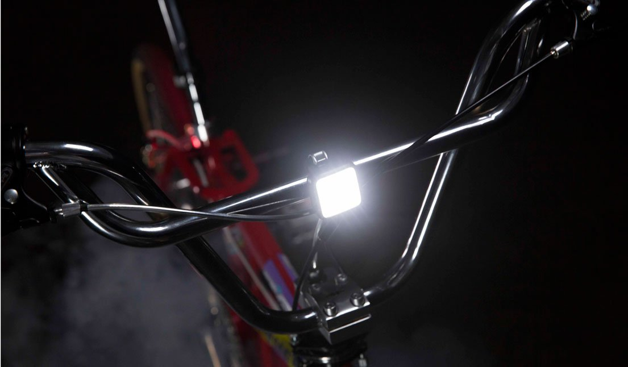
Be Visible

Slide 7
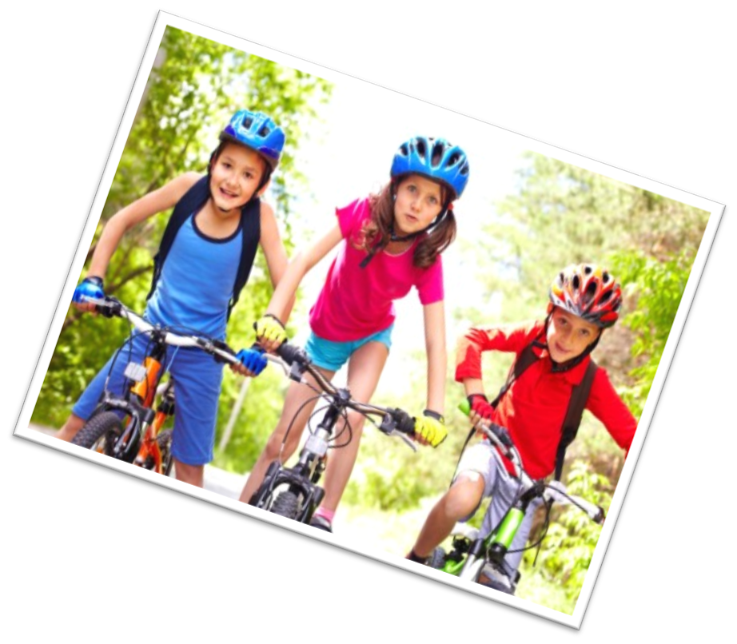
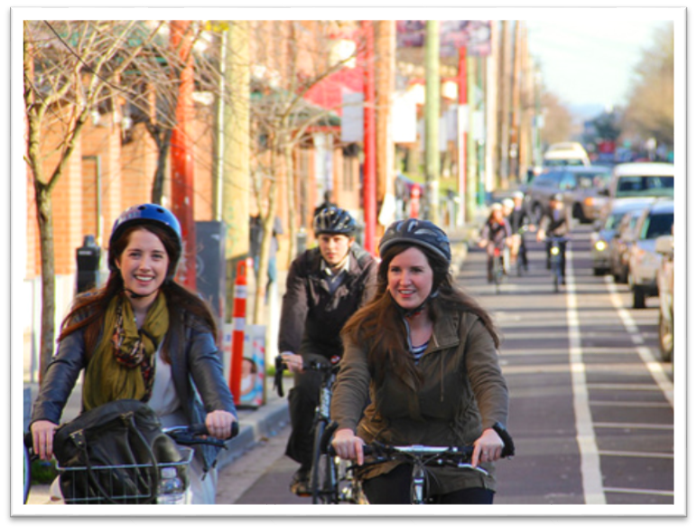
Ride Safely!

