Slide 1
AAA School Safety Patrol
Patrol Advisor Training

Slide 2
Background
The AAA School Safety Patrol program has more than 679,000 Patrollers in 35,000 U.S. schools.
The AAA School Safety Patrol Program plays an important role in helping pedestrians learn and fulfill responsibilities regarding traffic safety.
Education and safety groups have praised the program for reducing injuries and fatalities among schoolchildren ages 5 to 14.

Slide 3
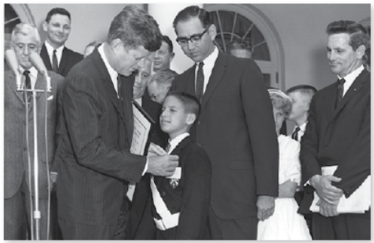
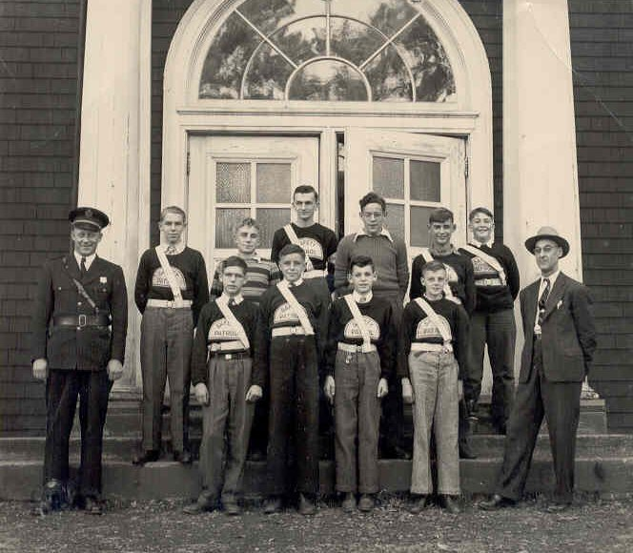
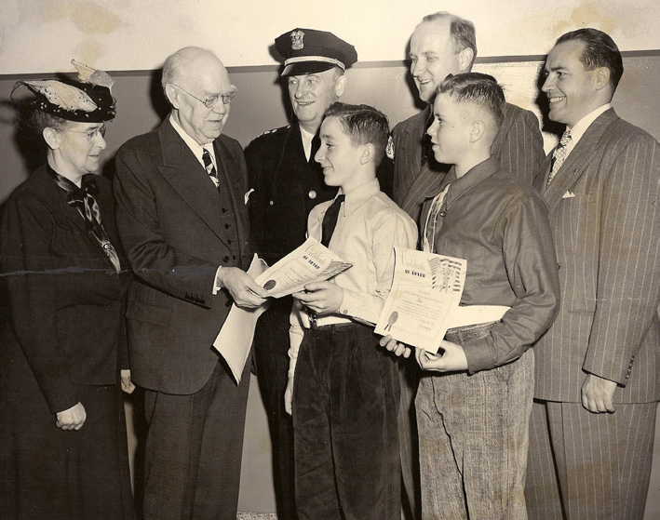
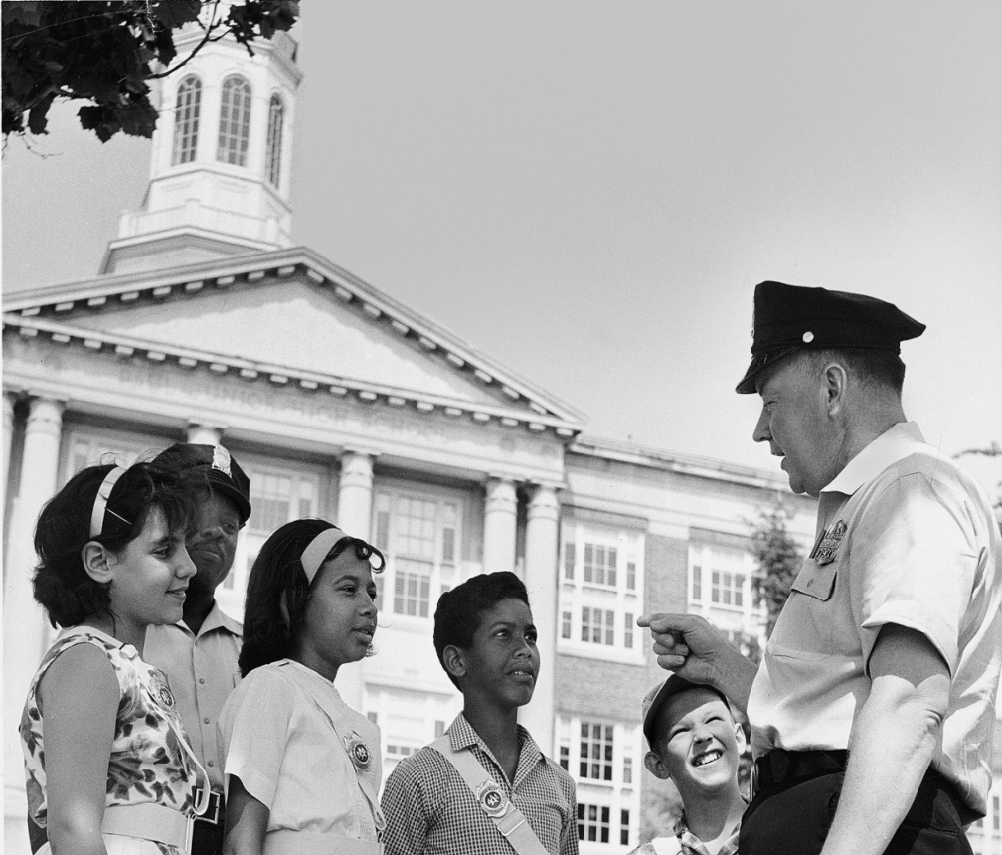
A Legacy of Leadership and Safety
As members of the AAA School Safety Patrol, students have protected their classmates since 1920.

Slide 4
Operations
Overview

Slide 5
Organizing Your Patrol |
General
Securing Official School Authorization
Before the school institutes the AAA School Safety Patrol program, they may have to obtain approval from the district administration or school board. The approval process will vary according to community and school districts.
Parental Permission
Students must have permission from parents or legal guardians to participate in the AAA School Safety Patrol Program.
Limiting Liability
Although AAA is unaware of any legal liability cases involving Patrol programs since the inception of the program in 1920, schools can take steps to minimize perceived liability and concerns.
Partnership
The most effective Patrol programs come from a strong partnership between AAA, schools, parent/teacher groups, law enforcement and the community.

Slide 6
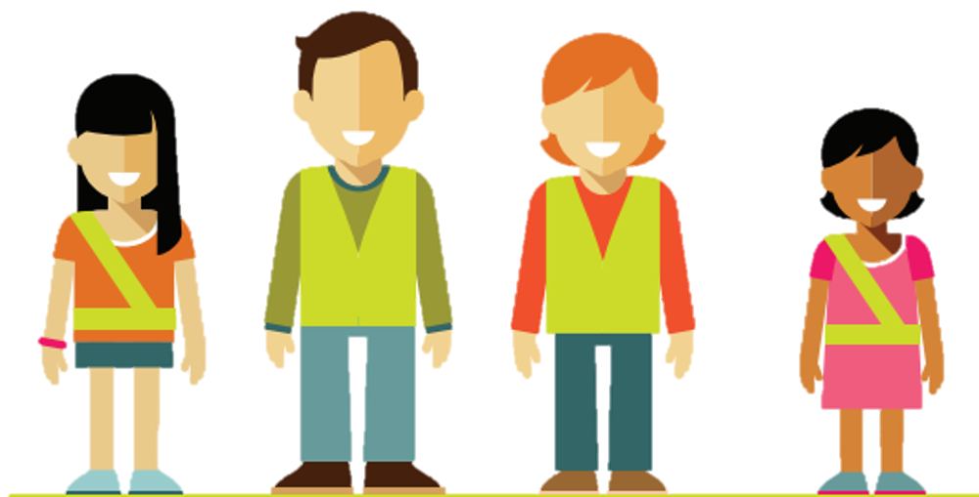
Organizing Your Patrol |
Patrol Advisor
Knowledge of traffic safety principles
An ability to inspire confidence and respect
A strong belief in the value of AAA’s program
Communication skills
Dependability
Leadership
Establish rapport with students and community
Organizational skills
The ideal Advisor demonstrates:
The AAA School Safety Patrol Advisor is a responsible adult appointed by the school to oversee the Patrol. More than any other individual, the Advisor determines the program’s success!
Notes:
First and foremost selecting the Patrol Advisor is critical to the program’s implementation and success.

Slide 7
Advisors’ duties include:
Serving as the source of information on all
aspects of the program
5 |
Conducting training sessions, reviews and
administrative meetings
1 |
Selecting Patrollers and assigning duties
Advising sponsoring committees on the Patrol’s activities
2 |
6 |
3 |
Training all Patrollers, including officers
7 |
Identifying and training an assistant or reserve
Advisor
Supervising all Patrol operations
Promote student cooperation, pride and efficiency in the Patrol
4 |
8 |

Slide 8
Operating Your Patrol |
Recruiting
Advisors and the principal should present the AAA School Safety Patrol program to upper-grade teachers optimally at a staff meeting or through other channels to disseminate information and garner support.
When the staff is on board:
Announce the program with a brief description at an assembly.
Follow-up with in-class recruitment presentations to upper-grade levels.
Start the recruitment process. Each school is responsible for determining its application process and how Patrollers will be selected.
1
2
3
All students should have the opportunity to apply even if they don’t meet the requirements in the eyes of their teachers or others. Doing so constitutes their desire to volunteer and serve their communities without promise of compensation. This is a great first step for all students!

Slide 9
Operating Your Patrol |
Training
Vital information to cover in training:
School training may be conducted via:
Training Camps:
Fundamentals of traffic safety
Duties of each Patrol post
Identifying sufficient gaps in traffic to allow for a safe crossing
Special hazards
Dealing with pedestrians and bicyclists
School bus safety procedures
Safety procedures on school grounds
Maintaining records (for officers)
Uniform wear and equipment care
Classes
On-the-job personal direction
Written guidelines and oral or written quizzes
Joint clinics held in cooperation with other schools and involving new and veteran Patrollers
Training videos from your local AAA club or the AAA Foundation for Traffic Safety, followed by discussion
Diagramming a duty corner and highlighting hazards and a plan for the specific crossing
School bus drills
Any combination of the above
Ideally scheduled just before the school semester begins
Provide an opportunity to combine traffic safety education with fun activities
Partner with law enforcement, local safety experts and representatives from your local AAA club, veteran Patrollers, and older alumni to lead class sessions
Most camps end with an exam and graduation ceremony
Be creative!
Thorough training is more than just recommended. It’s an absolute necessity put in place to protect Patrollers, other students and the school. Safety always comes first at AAA.

Slide 10
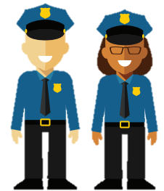
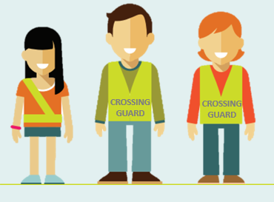
Operating Your Patrol |
Working Together
Working with other Patrollers:
Working with Law Enforcement:
Working with Adult Crossing Guards:
If a Patroller is working at a post with another Patroller, both should stand in the holding position with one person facing the street and the other facing the approaching students.
Both Patrollers check for traffic.
When they both agree there is a safe gap in traffic, they step aside and motion for the students to cross.
Both Patrollers continue looking all ways for approaching or turning vehicles.
Remember, teamwork is essential!
In many communities, law enforcement officers work directly with Patrols. They serve not only as mentors but also as Safety Patrol coordinators who contribute to operations, training and development.
Law enforcement can make an important contribution to the success of your program, including:
Promoting motorist awareness of Patrols
Promoting community respect for Patrols
Contributing to Patrol training
The adult crossing guard looks for oncoming traffic and helps find a safe time to cross.
The Patroller holds students at the curb in the holding position until receiving the crossing guard’s signal that it is safe to cross.
Patrollers should never attempt to stop or direct traffic and should always follow the crossing guard’s directions.
Return to the holding position after students cross or the guard signals that it is no longer safe to cross.
Remember, only police officers and adult crossing guards can stop vehicles.

Slide 11
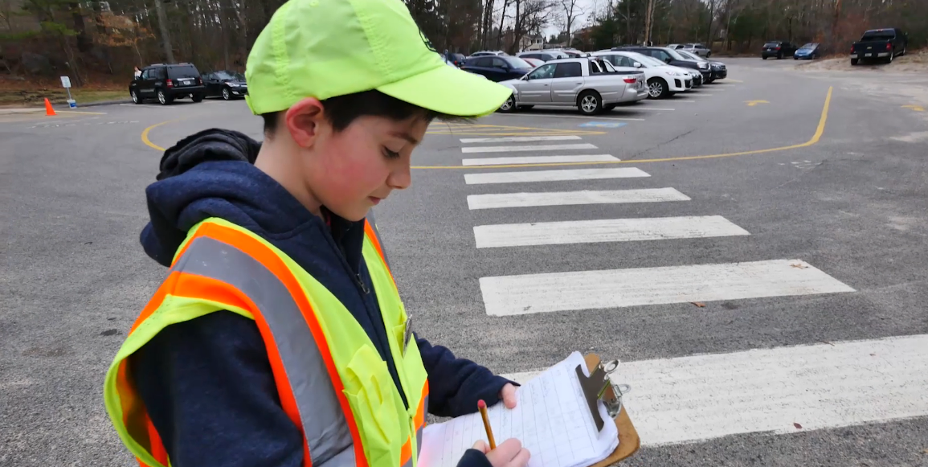
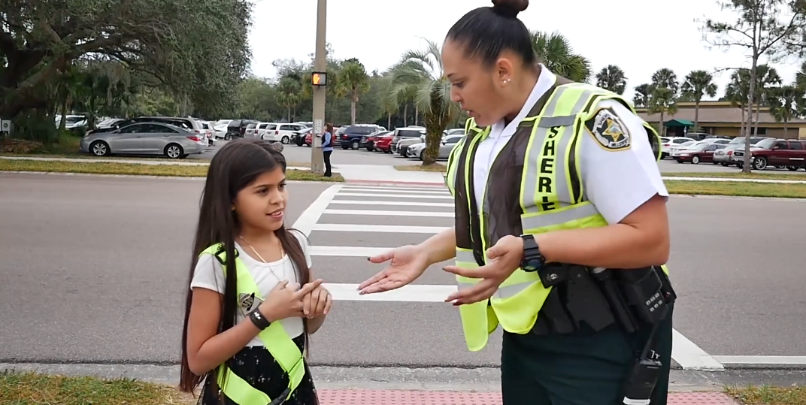
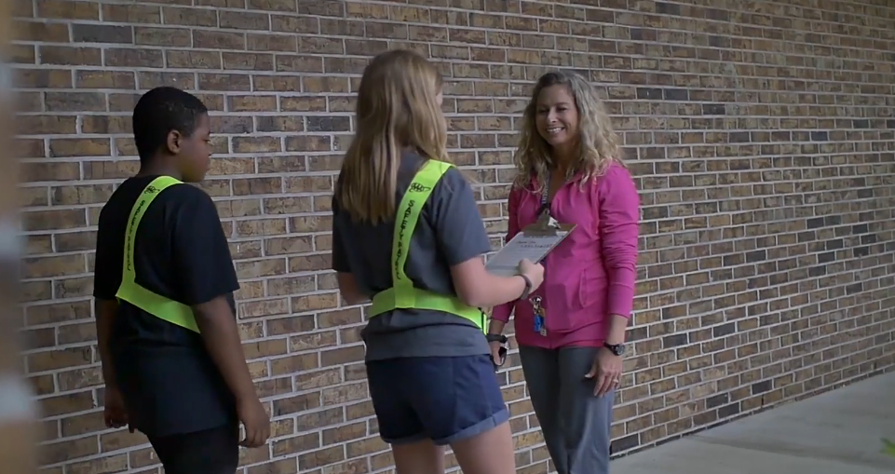
Operating Your Patrol |
Concerns
Sometimes, bad weather such as rain, snow, sleet or fog makes it more difficult to see or for drivers to stop their vehicle.
Even on bad-weather days, Patrollers must show up for duty on time. The exception would be if school was canceled due to weather conditions.
Allow extra time for students to cross by choosing visual reference points that are farther away.
Remember that in bad weather, it takes cars more time to stop.
Rain and fog make it harder for drivers to see traffic signs and pedestrians.
If it is snowing or icy, Patrollers should listen to TV or weather announcements or call the school hotline to determine whether classes are canceled or starting later than usual.
Watch for out-of-control vehicles when roads are wet or icy.
Patrollers are trained to seek the help of an adult in the following traffic situations:
Parked cars blocking the view of an intersection
Parked cars blocking a school bus stop or student loading or unloading zone
Failure of motorists to obey a traffic control device
If you witness a traffic collision, stay at your post, keep students out of the street, and send someone to the school to report it to an adult.
Wrong-way traffic on a one-way street
Emergency vehicle response near the post
If Patroller sees a traffic violation, write down the vehicle’s color and license plate number and report it to the Advisor.
Vehicles turning at a T-intersection
INCLEMENT WEATHER
TRAFFIC
Emergencies may include vehicle crashes, collisions involving vehicles and pedestrians or bicyclists, sudden illness of pedestrians or motorists, or injury of pedestrians or bicyclists.
If an emergency has occurred, the Patrol Advisor should ask multiple motorists to call 911 to report it.
“Stranger Danger” Patrollers are trained to report problems with strangers to a Patrol Advisor, teacher, parent and/or law enforcement. “Stranger Danger” precautions should be a part of Patrol training. Patrollers should be taught that if grabbed by a stranger, to make as much noise as possible!
Patrollers are trained to seek the help of an adult in the following situations:
If you see a student being unsafe at your post, ask him or her nicely to stop the unsafe behavior. If the behavior continues, report this activity to your Advisor.
Suspicious activity by an adult or other students
Emergencies and injuries
Electrical wires down near the patrol post
Domestic or wild animal threats
Student violence
Any situation beyond the realm of the daily operation of a Patrol post
EMERGENCIES
OTHER
Notes:
On click animation occurs

Slide 12
Safety Patroller
Overview

Slide 13
Safety Patroller |
Role
Patrollers should demonstrate:
Leadership qualities
Sound judgement
Teach fellow students about traffic safety
4 |
Creativity is the key to success in this ppt future and primary education.
Maturity
Good attendance record
Reliability
Courtesy for others
5
Ability to follow rules and actively listen
Respect
7 |
Punctuality
Desire to help others
Interest in traffic, pedestrian & bicycle safety
Ability to perform duties
AAA School Safety Patrol members are school sponsored student volunteers from upper elementary and middle schools.

Slide 14
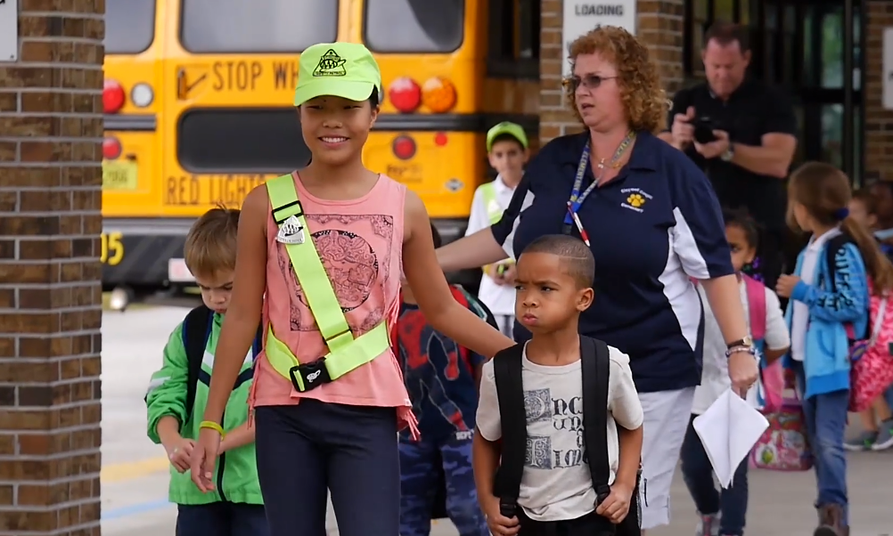
Safety Patroller |
Duties
Patrollers’ duties include:
1 |
Complete traffic safety training
4 |
Teach fellow students about traffic safety
Protect students from the hazards of crossing roads on their way to and from school
Serve other leadership functions under the direction of school officials
2 |
5 |
Identifying and training an assistant or reserve
Advisor
Assist bus drivers in safely transporting students to and from school
7 |
3 |
6 |
Serves as role models for younger children
Patrollers direct children, not traffic!

Slide 15
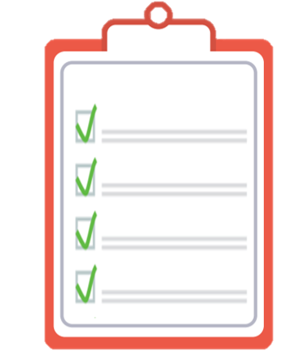
Safety Patroller |
Eligibility
Eligible students must:
Be enrolled in grades 4 through 8
Successfully complete AAA School Safety Patrol training
Submit a Patrol Application with parental consent
Meet your school’s participation requirements

Slide 16
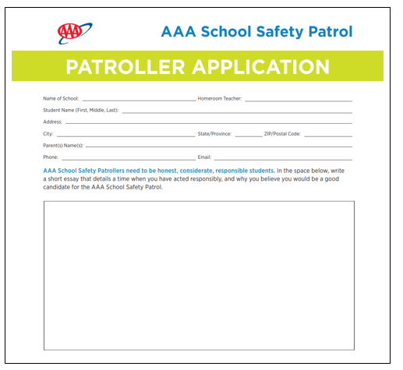
Safety Patroller |
Application
Patrollers are expected to:
Arrive early to school or stay late after school on the days they are assigned to be at their post
Stay on top of their schoolwork
Commit to setting an example while on and off duty
Review the application process
Application process may include:
Interested students taking home an informational package, including an application and a letter explaining how qualified applications will be selected and noting that space on the Patrol is limited
Interested students returning the application by a due date
The Advisor reviewing the applications and forwarding selections to the principal for final approval
Informing selected students and notifying them of when their training and Patrol service will begin
Distributing a list of Patrollers to teachers so they are aware of which students may arrive late to class or need to leave early
Training reserve Patrollers to account for attrition

Slide 17
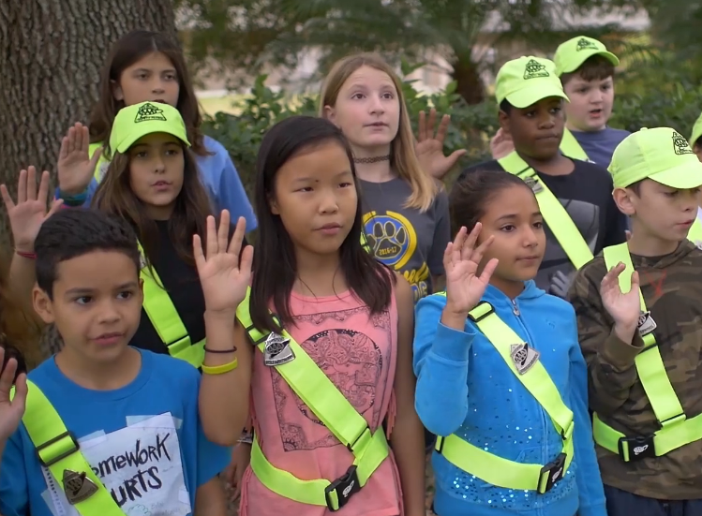
Safety Patroller |
Pledge
AAA School Safety Patrol Pledge
I promise to do my best to:
Report for duty on time
Perform my duties faithfully
Strive to prevent traffic crashes, always setting a good example myself
Obey my teachers and officers of the Patrol
Report dangerous student practices
Strive to earn the respect of fellow students
Golden Rules of Service
Treat others as you would like to be treated
Patrollers, including officers, will perform post duties as needed to ensure the integrity of service and the safety of the community
No Patroller is above performing any duty as circumstances dictate

Slide 18
Supporting
Your Patrol

Slide 19
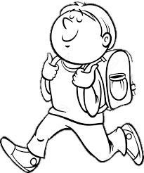
Supporting Your Patrol |
Benefits
Students gain:
Schools benefit from opportunities to promote:
Safety awareness
Pride
Traffic safety awareness
Teamwork
Peer-to-peer education
Leadership
Character-building opportunities
Citizenship
A constructive outlet for students’ energy
Respect for law enforcement
A positive relationship with parents, law
enforcement and the overall community
Communities benefit from:
Safer environments for pedestrians, bicyclists
and motorists
A spirit of a connected community, volunteerism and civic-mindedness
A positive collaboration between students,
parents, schools and law enforcement

Slide 20
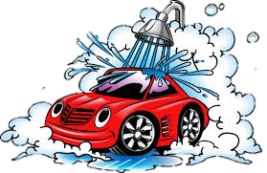
Supporting Your Patrol |
Fundraising
Schools across the country have raised funds for their Patrol by:
Hosting a movie for students and selling popcorn
Creating buttons or stickers for a small cost
Setting up a booth at a town street fair or similar community celebration and providing face painting or simple goods or services
Selling plants or seedlings obtained from the Parks dept.
Holding a bake sale
Holding a safety fair and inviting AAA, the Red Cross or other safety organizations to participate
Offering a gift-wrapping service at the holidays
Holding car washes
Challenging students to a walk-a-thon, bike-a-thon (with helmets!) or bowl-a-thon and asking sponsors to pledge contributions
Collecting recyclables
Contacting fundraising companies that provide sale items

Slide 21
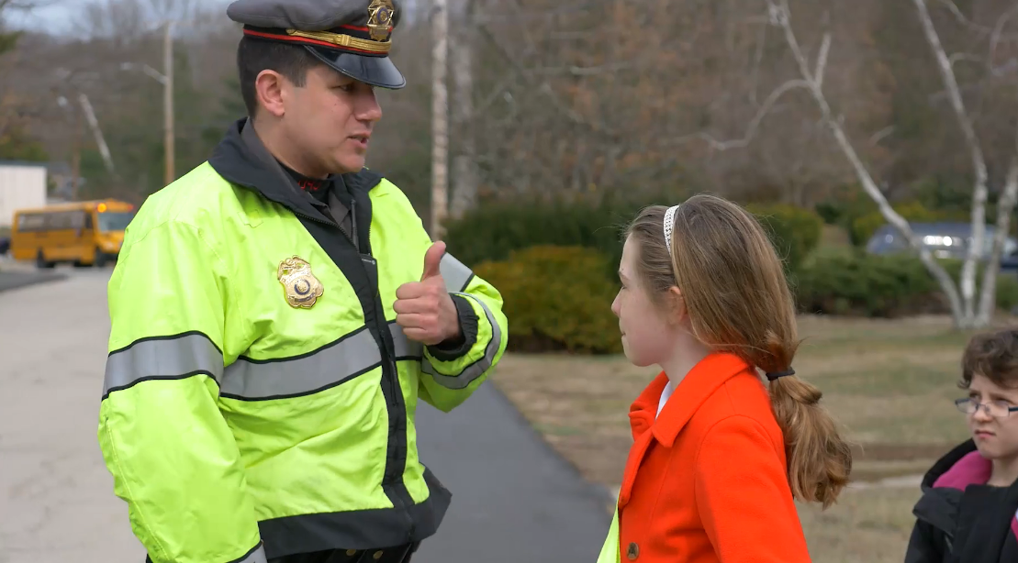
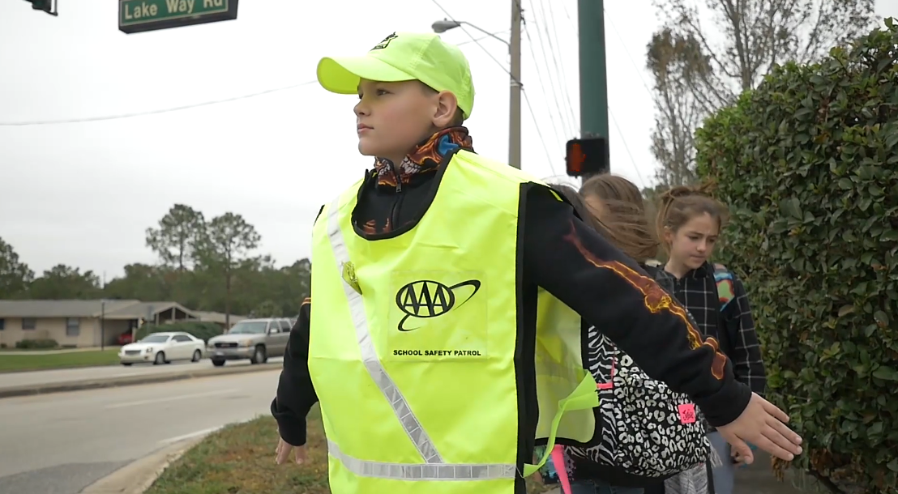
Supporting Your Patrol |
Partnership Roles
The most effective Patrol programs come from a strong partnership between AAA, schools, parent-teacher groups, law enforcement and the community.
The Role of AAA
Public outreach and recognition
Resources, including equipment and program guidelines
Traffic safety education, logistical support and awareness presentations
Sponsorship
The Role of the School
Principals appoint teachers to serve as Patrol Advisors. Advisors implement AAA School Safety Patrols within the school and meet with other area Advisors to exchange best practices.
The Role of the Parent-Teacher Group
Supports the school’s Patrol program
Implements recognition programs
Serves as the liaison between the school and community
Sponsors equipment and training
The Role of Law Enforcement or Traffic Engineering Officials
Serve as a program consultant
Advocate on the Patrol’s behalf to motorists and the community
Contribute to the Patrol’s training and development
The Role of the Community
Civic organizations may provide recognition and community awareness programs.

Slide 22
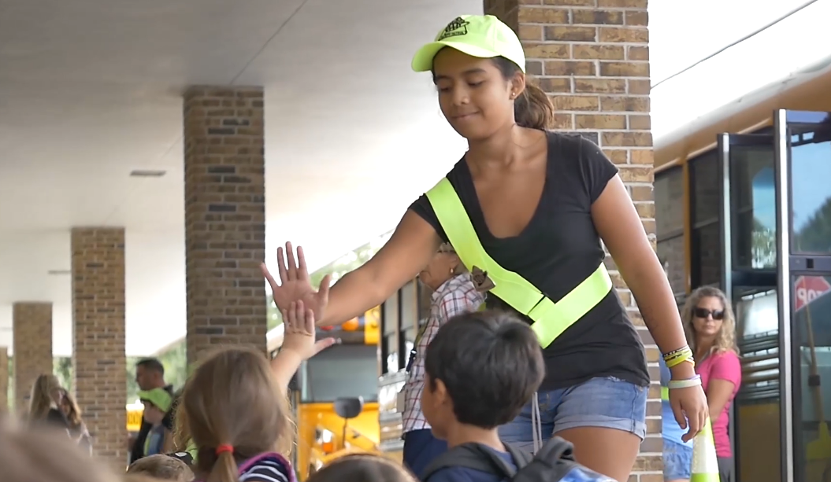
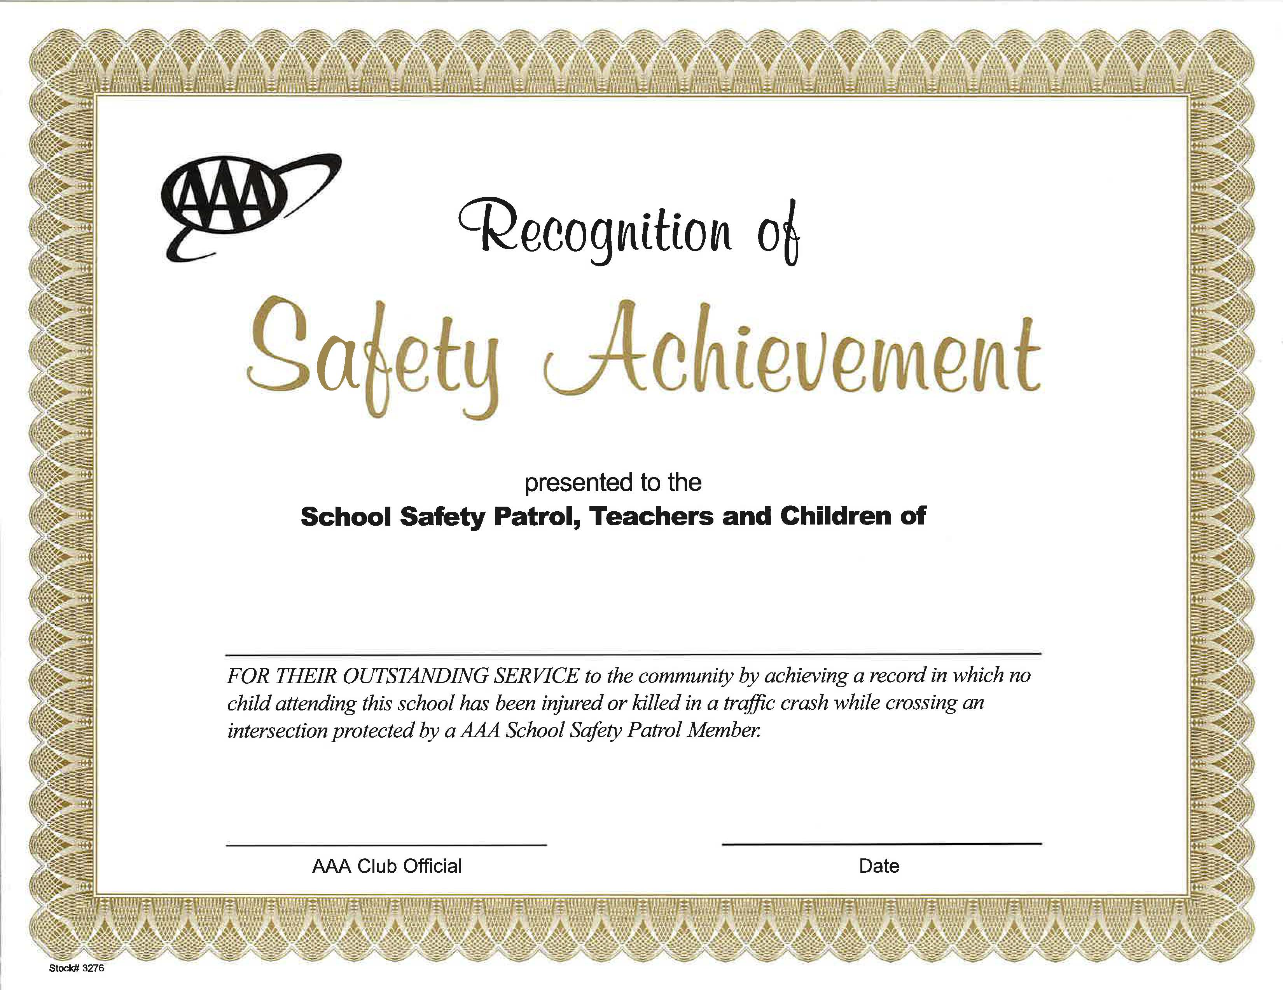
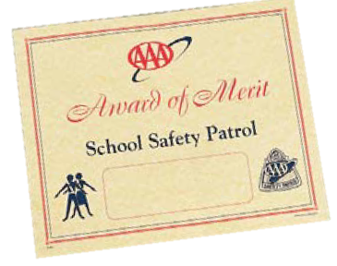
Supporting Your Patrol |
Recognition
Morale Building
A role of the Advisor is to maintain the enthusiasm and commitment of the Patrol team. The more a school community supports and recognizes the Patrollers’ responsibilities, the higher their morale. A Certificate of Recognition and merit pins are available for students who complete service as a Patroller. These can be presented at school assemblies or patrol events.
Suggested activities to build pride and morale:
Hold bimonthly meetings
Reserve a section of the school newsletter to Safety Patrol news.
Recognize a Patroller of the Week/Month
Host special events such as pizza parties, movie outings, sporting events, end-of the year celebrations, etc.
Be creative!

Slide 23
Supporting Your Patrol |
Recognition
Lifesaving Medal
In 1949, AAA awarded the first Lifesaving Medals to recognize Patrollers who saved a life or prevented the injury of a fellow student while on duty. More than 422 students have received this prestigious honor. The Lifesaving Medal is awarded by an independent review board to a member of any authorized AAA School Safety Patrol.
National Patroller of the Year
In 2002, AAA/CAA introduced the National Patroller of the Year award to recognize Patrollers who best exemplify leadership qualities while performing their duties effectively and responsibly, without incident.
School Safety Patrol Advisors may nominate one current-year Patroller. Local AAA/CAA clubs select the National Patroller of the Year.
Contact your AAA club at AAASchoolSafetyPatrol@acg.aaa.com
for instructions on how to apply!

Slide 24
Resources

Slide 25
Resources |
Safety Patrol Materials
At Your Post Training Video
AAA School Safety Patrol Program Catalog
This video serves as a resource to community organizations, school administrators, and law enforcement agencies to aid in coordinating a AAA School Safety Patrol Safety Patrol program locally.
Printed materials, awards, equipment and other resources are available to support your AAA School Safety Patrol program. Schools and municipalities should order from their local AAA club. Available materials include:
Link: AAA.com/AtYourPost
Recognition Awards
Certificates
Patches
Pins
AAA School Safety Patrol Operations Manual
Printed Materials, Guides and Forms
Handbooks
Brochures
Manuals
Captain’s Record Book
Policies and Practices
The policies and practices presented in the manual are the result of the combined efforts of several national educational, law enforcement and safety organizations. It represents the cumulative experience of AAA School Safety Patrol operations across North America.
Patrol Equipment
Belts or vests
Badges
Caps
Ponchos
Flags
AAA School Safety Patrol Website
These tools are everything you need to create a new or expand an existing Patrol!

Slide 26
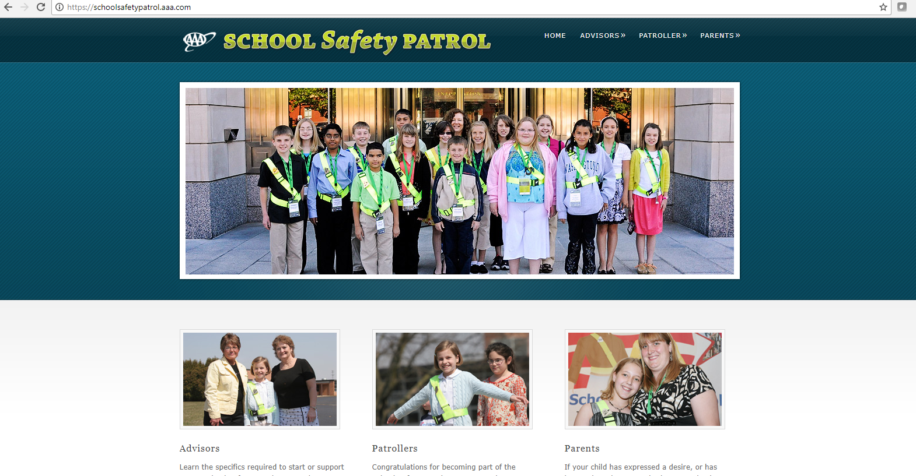
Questions/Comments?
Please email:
AAASchoolSafetyPatrol@acg.aaa.com
More resources can be found at AAA.com/SafetyPatrol

